Slide 1

STOCK MARKET INVESTMENT STRATEGY
Presenter Name

Slide 2



Agenda
Problem statement
Introduction
Exploratory Data Analysis
Conclusion
Recommendations

Slide 3

What is the best long term investment strategy for a R100,000?

Slide 4


Introduction
S & P 500 giants: Microsoft and Amazon
Cryptocurrency giant: Bitcoin
Inflation rate

Slide 5

EXPLORATORY DATA ANALYSIS

Slide 6
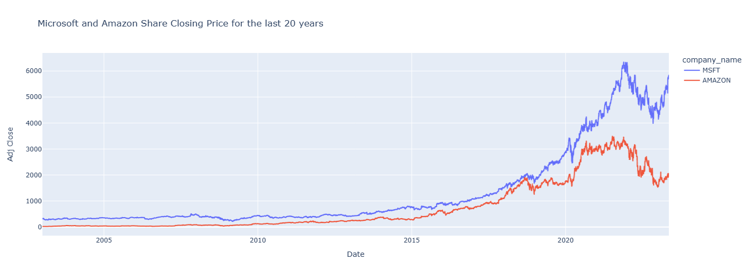
Closing Price : MSFT & AMZN
- Microsoft stock has been on an up trend from 2003 till 2021 Dec then it decreased a little bit but did not move than the average increase it had previously.
- Amazon stock has been increasing from 2003 Jan till 2020 end of August then from there the stock price has been fluctuating between the period 2020 Sep till 2022 April.

Slide 7
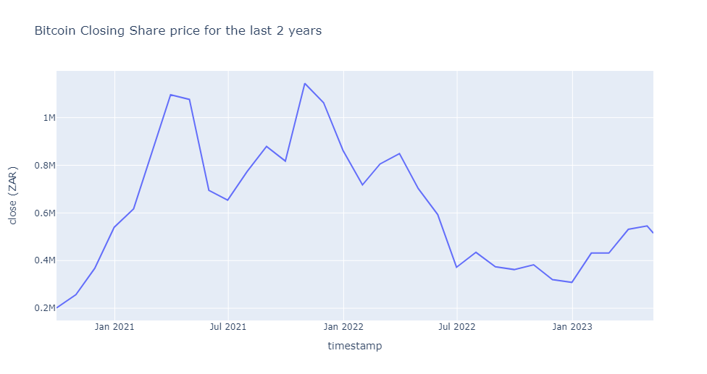
Closing Price Bitcoin
-Trend was increasing until March 2021 and dropped a bit and increased again until October 2021.
- After October 2021 it dropped drastically may be to Russia and Ukraine war.

Slide 8
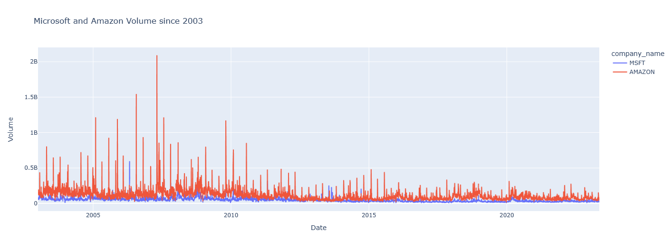
Sales Volume : MSFT & AMZN
The volume for sales of amazon is higher than for Microsoft because amazon has been providing their services online which showed that most people trusted it with online transactions compared to Microsoft which was not that popular online as compared to amazon.

Slide 9
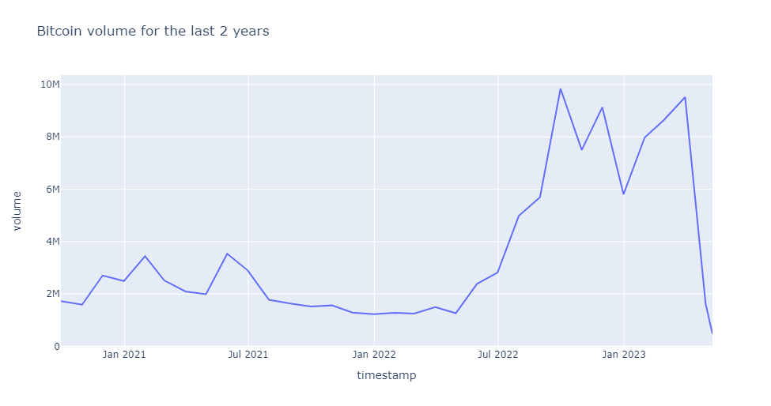
Sales Volume Bitcoin
- Bitcoin was low most people thought it was the right time to buy Bitcoin since it was cheap so they hoped that it might gain strength
- Since the ongoing war made it lose more value hence you saw a lot of people dropping their investments from it since it was too risky to invest in.

Slide 10
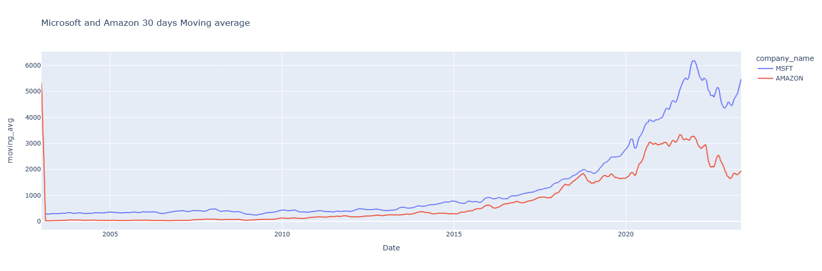
30-day Moving Average
- moving average for Microsoft is showing an uptrend so it is most likely to maintain that trend given its investments and its products which shows dominancy in the computer space and its expansion in the technological space.

Slide 11
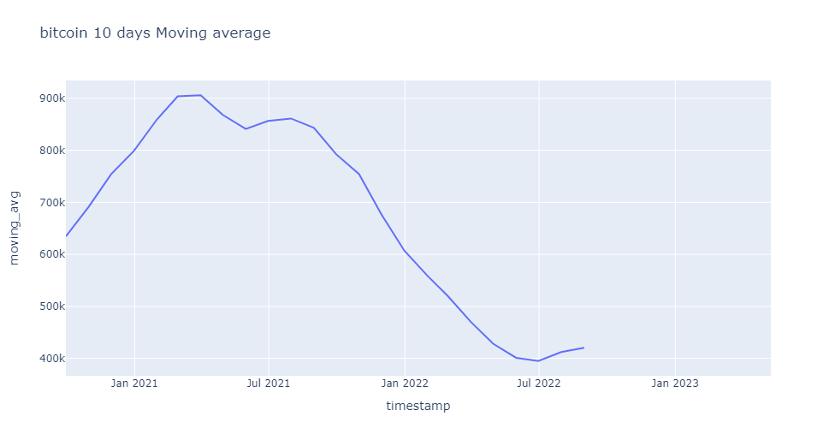
Bitcoin: 10-day Moving Average
- rolling sum of 10 days due to not having enough data and using a rolling sum of higher days can be misleading but we can see that the moving average is going down since 2021 as we mentioned that bitcoin has lost value in the past 2 years.

Slide 12
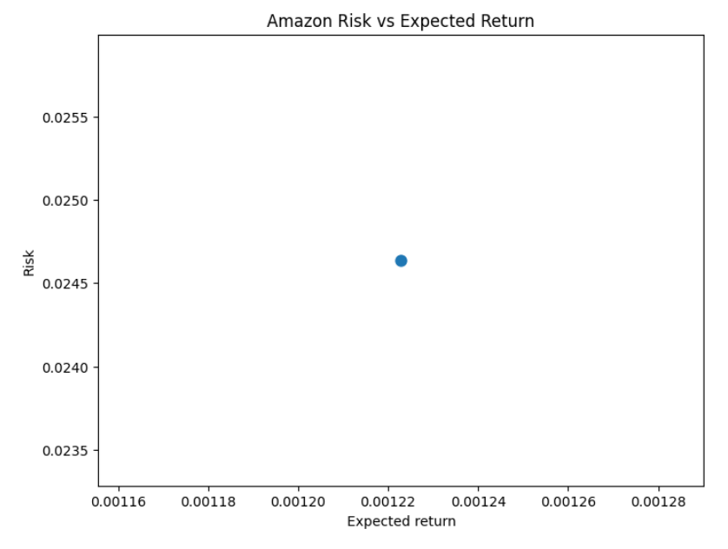
Amazon Risk vs Expected Return
-The expected return to Risk is reasonable considering that we are looking to invest long-term.

Slide 13
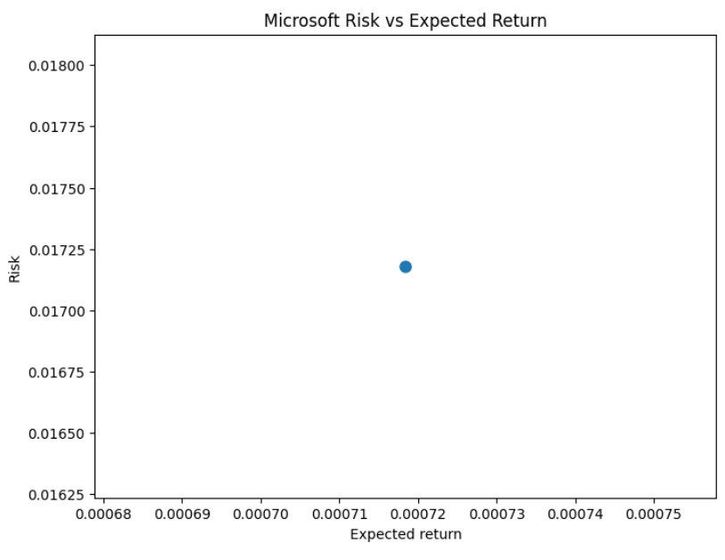
Microsoft Risk vs Expected Return
- The expected return to Risk is reasonable considering that we are looking to invest long term.

Slide 14
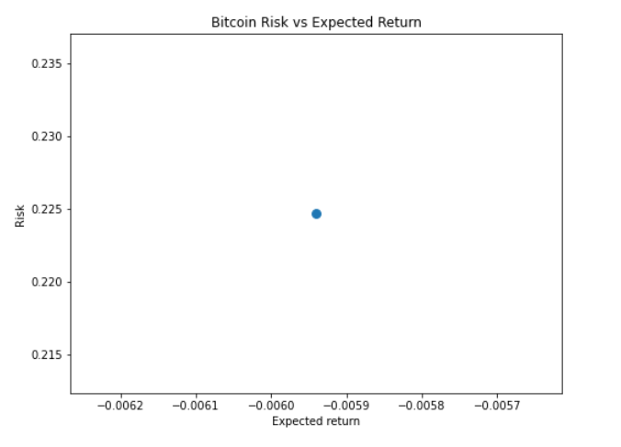
Bitcoin Risk vs Expected Return
- Bitcoin has the highest risk as to the other stocks and the returns are a loss so it would not be wise to invest to it due to the votility of the stock and it not yielding enough returns for a profit.

Slide 15
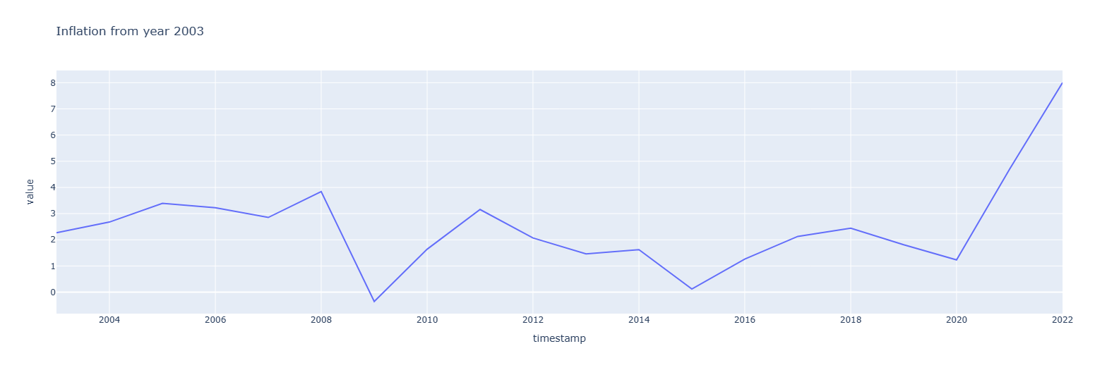
Inflation Rate
- The overall trend is increasing even though there was a drastic drop in 2008. In 2020 we observed a sharp increase in inflation and it has never shown any sign of dropping.

Slide 16
The way to get started is to quit talking and begin doing.
Walt Disney

Slide 17
Conclusion
Inflation seem to be increasing moving forwards.
Microsoft has a better risk to return.
Bitcoin is the worst
Investing in Microsoft could be the best strategy based on our analysis.

Slide 18
Recommendations
The analysis net can be wide to include other markets.
A forecasting model can be useful.
Domain knowledge can help in better insights.

Slide 19


Thank You

